Slide 1
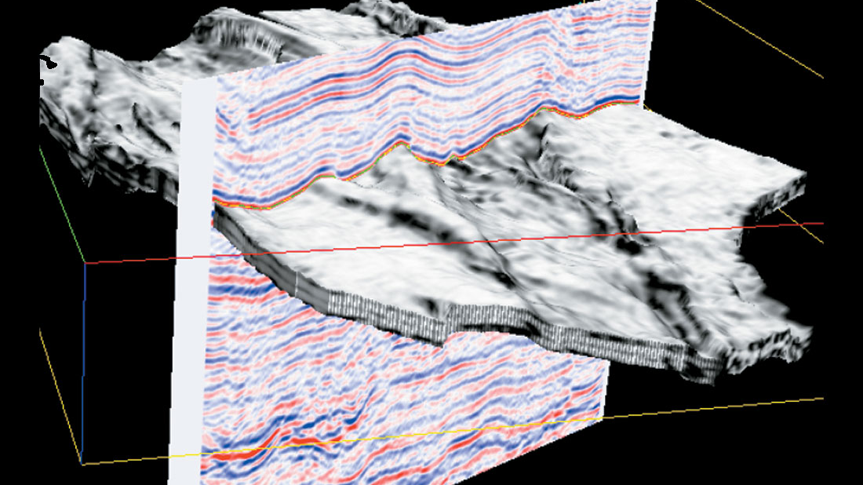
Fall 2018 - DATA MINING FOR BUSINESS (BYGB-7967-003) Seismic Bumps Dataset: Evaluation and Conclusions
Team 4:
Lakshmi Sravya Katta Ila Srivastava Josh Simpson
Team 4:
Lakshmi Sravya Katta
Ila Srivastava
Josh Simpson

Slide 2
Dataset Background
The data describe the problem of high energy (higher than 10^4 J) seismic bumps forecasting in a coal % mine. Data come from two of longwalls located in a Polish coal mine.
Mining activity was and is always connected with the occurrence of dangers which are commonly called mining hazards.
A special case of such threat is a seismic hazard which frequently occurs in many underground mines.
The task of seismic prediction can be defined in different ways, but the main aim of all seismic hazard assessment methods is to predict (with given precision relating to time and date) of increased seismic activity which can cause a rockburst.
In the data set each row contains a summary statement about seismic activity in the rock mass within one shift (8 hours). If decision attribute has the value 1, then in the next shift any seismic bump with an energy higher than 10^4 J was registered.

Slide 3
Real World Deployment
With the information about the possibility of hazardous situation occurrence, an appropriate supervision service can reduce a risk of rockburst (e.g. by distressing shooting) or withdraw workers from the threatened area.
Classification of occurrence of high energy seismic bumps in a coal mine will help the mine workers in inferring the hazardous state of the mine. This way, proper safety precautions and preventive methods can be taken
Data usage by researchers, mine safety experts and other employees in improving the safety conditions in coal mines.
Good prediction of increased seismic activity is therefore a matter of great practical importance.

Slide 4
Data Description
Data Source
https://archive.ics.uci.edu/ml/datasets/seismic-bumps
Marek Sikora^{1,2} (marek.sikora@polsl.pl), Lukasz Wrobel^{1} (lukasz.wrobel@polsl.pl)
(1) Institute of Computer Science, Silesian University of Technology, 44-100 Gliwice, Poland
(2) Institute of Innovative Technologies EMAG, 40-189 Katowice, Poland
Data characteristics
Instances: 2584
Attributes: 18 + class
Class distribution: "hazardous state" (class 1) : 170 (6.6%) | "non-hazardous state" (class 0): 2414 (93.4%)
Missing Attribute Values: None

Slide 5
Attribute information:
1. seismic: result of shift seismic hazard assessment in the mine working obtained by the seismic method (a - lack of hazard, b - low hazard, c - high hazard, d - danger state);
2. seismoacoustic: result of shift seismic hazard assessment in the mine working obtained by the % seismoacoustic method;
3. shift: information about type of a shift (W - coal-getting, N -preparation shift);
4. genergy: seismic energy recorded within previous shift by the most active geophone (GMax) out of % geophones monitoring the longwall;
5. gpuls: a number of pulses recorded within previous shift by GMax;
6. gdenergy: a deviation of energy recorded within previous shift by GMax from average energy recorded % during eight previous shifts;
7. gdpuls: a deviation of a number of pulses recorded within previous shift by GMax from average number % of pulses recorded during eight previous shifts;
8. ghazard: result of shift seismic hazard assessment in the mine working obtained by the % seismoacoustic method based on registration coming form GMax only;
9. nbumps: the number of seismic bumps recorded within previous shift;
10. nbumps2: the number of seismic bumps (in energy range [10^2,10^3)) registered within previous shift;
11. nbumps3: the number of seismic bumps (in energy range [10^3,10^4)) registered within previous shift;
12. nbumps4: the number of seismic bumps (in energy range [10^4,10^5)) registered within previous shift;
13. nbumps5: the number of seismic bumps (in energy range [10^5,10^6)) registered within the last shift;
14. nbumps6: the number of seismic bumps (in energy range [10^6,10^7)) registered within previous shift;
15. nbumps7: the number of seismic bumps (in energy range [10^7,10^8)) registered within previous shift;
16. nbumps89: the number of seismic bumps (in energy range [10^8,10^10)) registered within previous shift;
17. energy: total energy of seismic bumps registered within previous shift;
18. maxenergy: the maximum energy of the seismic bumps registered within previous shift;
19. class: the decision attribute - "1" means that high energy seismic bump occurred in the next shift % ("hazardous state"), "0" means that no high energy seismic bumps occurred in the next shift % ("non-hazardous state")

Slide 6
Dataset Limitations:
The presented data set is characterized by unbalanced distribution of positive and negative examples. In the data set there are only 170 positive examples representing class 1.
Currently used methods are still insufficient to achieve good sensitivity and specificity of predictions.
Complexity of seismic processes and big disproportion between the number of low-energy seismic events and the number of high-energy phenomena (e.g. > 10^4J) causes the statistical techniques to be insufficient to predict seismic hazard.
Therefore, it is essential to search for new opportunities of better hazard prediction, also using machine learning methods.

Slide 7
Methodology
Data Collection
Variable Selection
Model Building
Evaluation
Conclusion

Slide 8
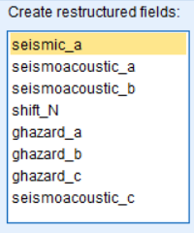
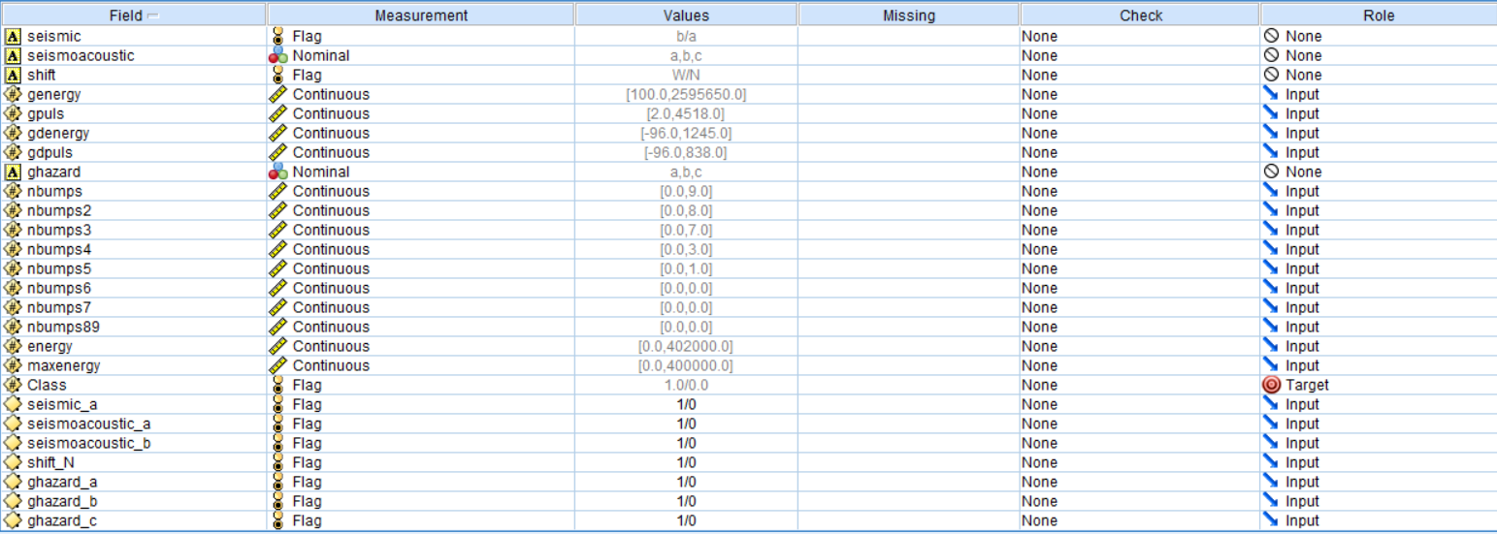
Variable Selection
Checking for outliers using outlier and extreme super node in data audit.
Usage of restructure node to remove the unnecessary variables

Slide 9

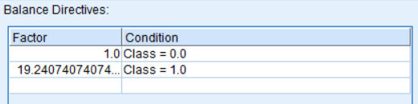

Balancing Node
Before >
After >

Slide 10
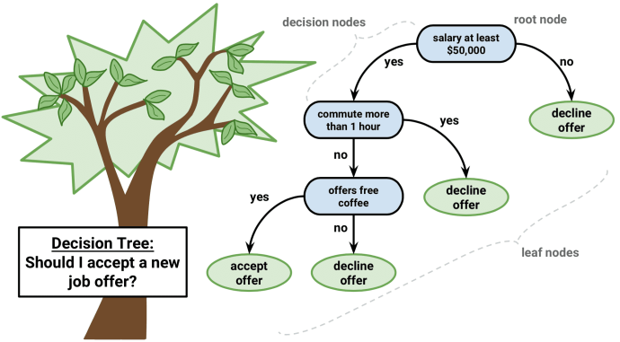
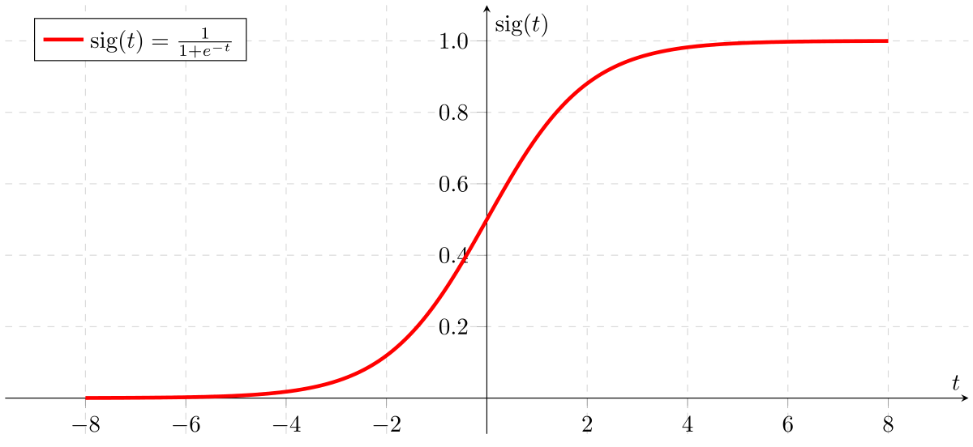
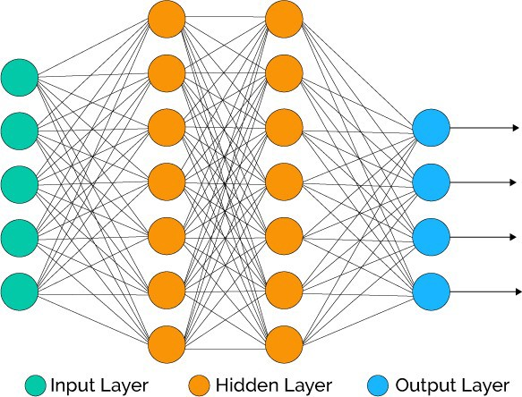
Model Building
Our team built classification models, such as decision tree, artificial neural networks and logistic regression model to analyze various attributes and their importance when it comes to predicting the occurrence (or lack thereof) of high energy seismic bumps in next shift.
We will also build an Ensemble of classifiers, in order to get a classifier of higher accuracy, than each of the constituent classifier.

Slide 11
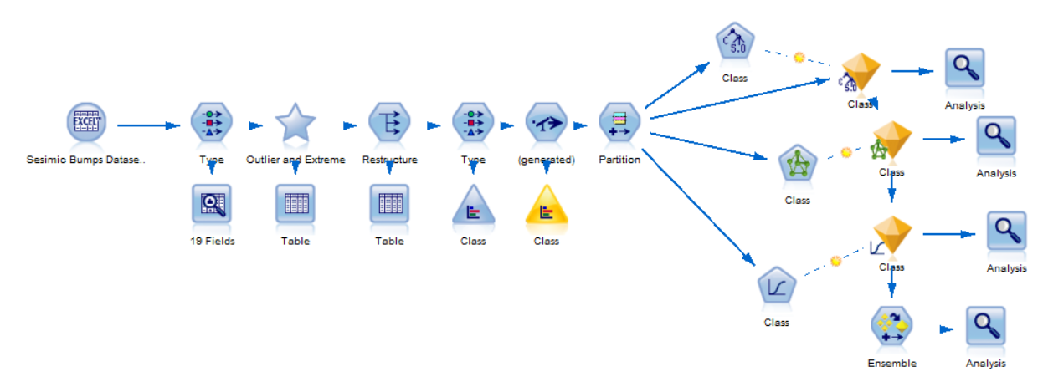
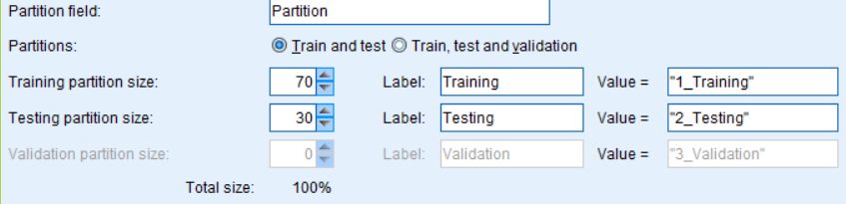
Model Stream

Slide 12
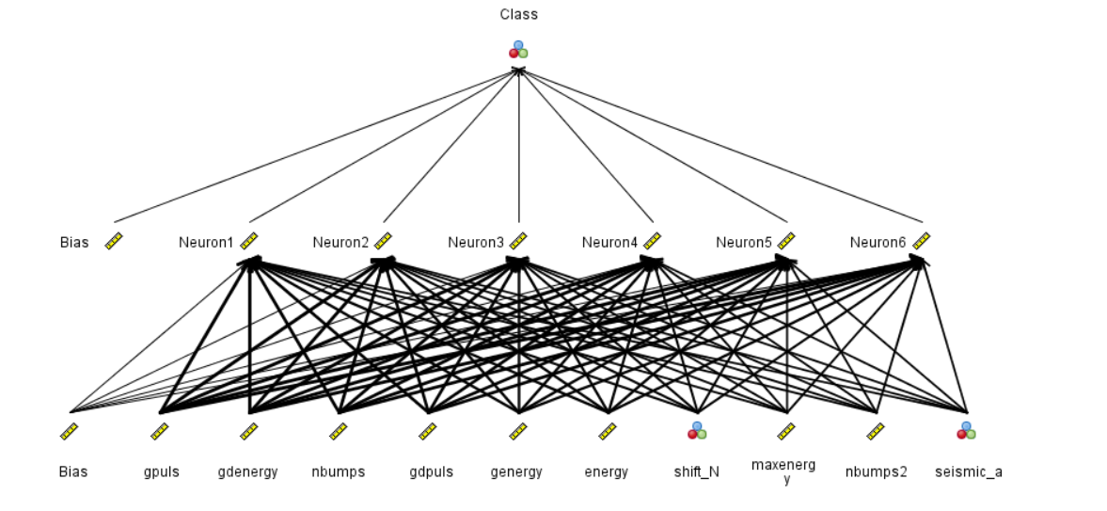
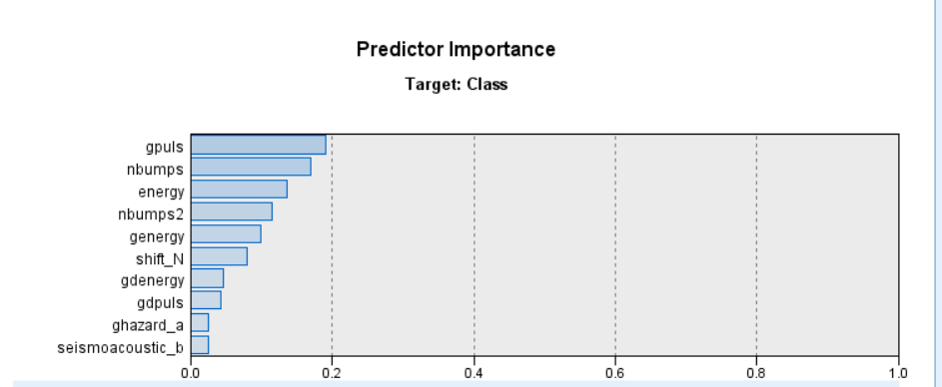
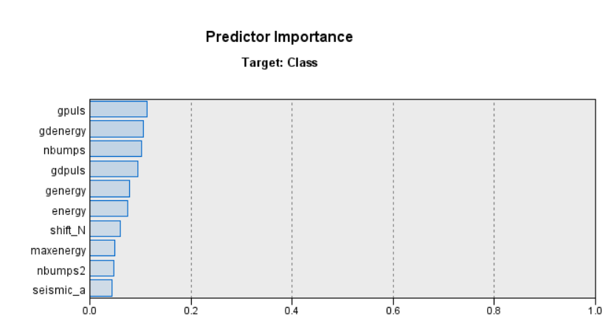
Predictor Importance
Decision Tree
Neural Network

Slide 13
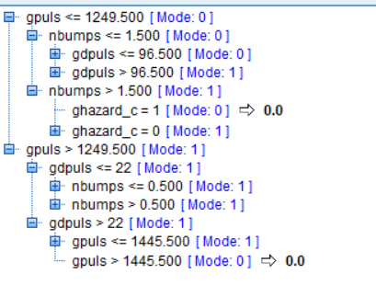
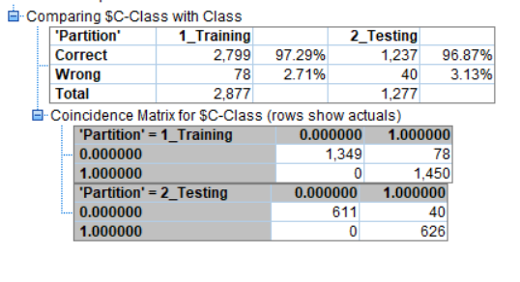

Decision Tree Output

Slide 14
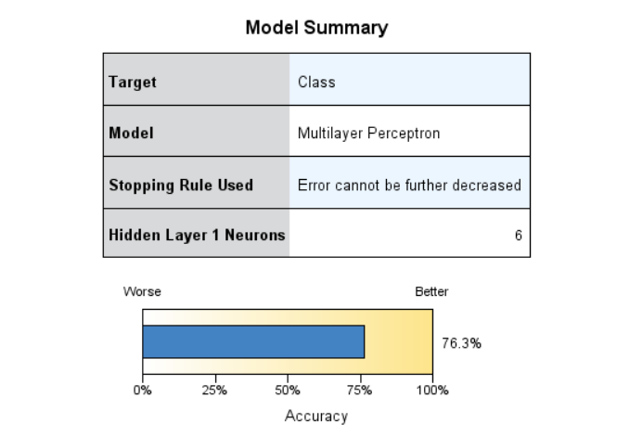
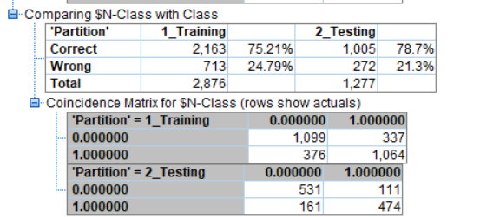


ANN Analysis Output

Slide 15
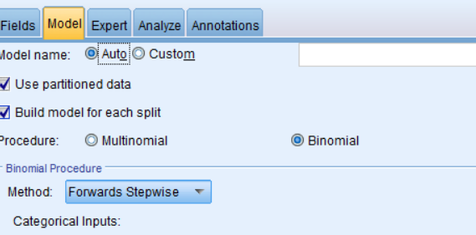

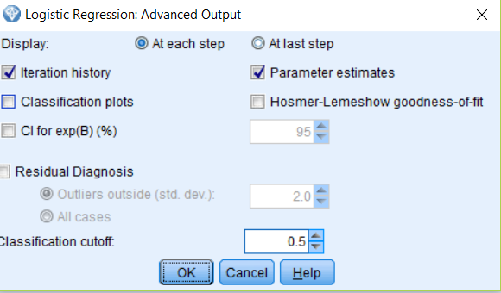
Logistic Regression Output

Slide 16
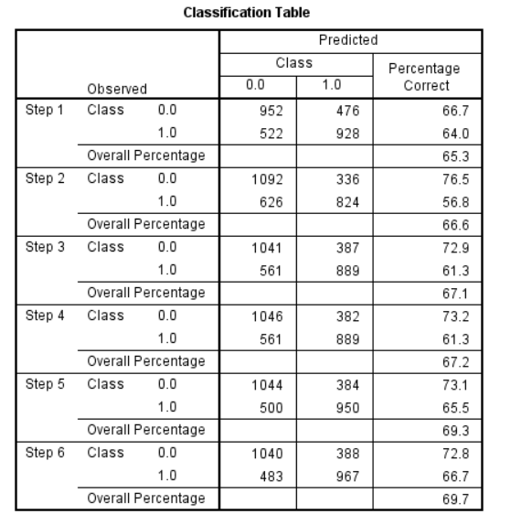
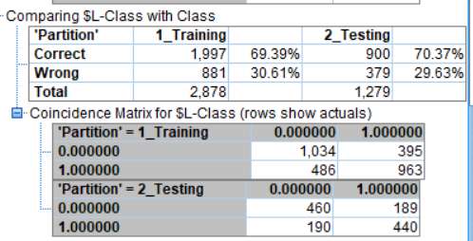



Slide 17
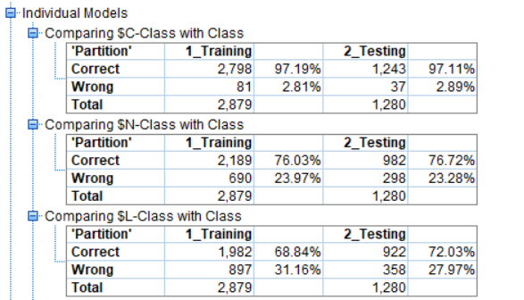
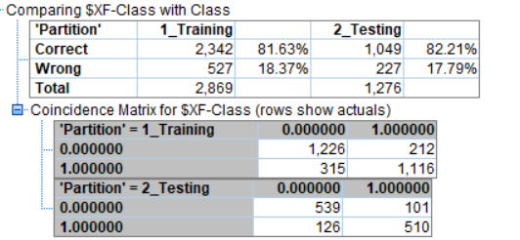
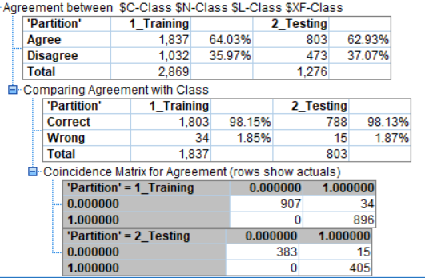







Ensemble of Classifiers

Slide 18

Classifier Evaluation Metrics: Decision Tree
Precision = % of instances that the classifier predicted as positive that are actually positive
= (TP / TP + FP)
= (611 / 611 + 40)
=> 93.85 %
Recall = % of positive instances that the classifier predicted correctly as positive
= (TP / TP + FN)
= (611 / 611 + 0)
=> 100 %

Slide 19

Classifier Evaluation Metrics: Ensemble
Precision = % of instances that the classifier predicted as positive that are actually positive
= (TP / TP + FP)
= (539 / 539 + 101)
=> 84.2%
Recall = % of positive instances that the classifier predicted correctly as positive
= (TP / TP + FN)
= (539 / 539 + 126)
=> 81.05%

Slide 20
Key Findings and Conclusions
Dataset was clean nevertheless, some improvisations were made to get good accuracy percentage.
Based on the overall accuracy, decision tree is the best performing model with 97% (approx.) accuracy.
Ensemble Classifier has given better accuracy than ANN and logistic regression model but not decision tree. Therefore, we will stick with Decision tree as the final model.
Dependent variables of ‘gpuls’ and ‘nbumps’ have high predictor importance across multiple models.
Due to the overall high accuracy of the model, the coal mine workers can use the model to predict whether the seismic bump in the next shift will be hazardous or not.
In order to prevent further incidents, safety and preventive measures can be undertaken beforehand.

Slide 21
Thank You!
Question time

